Slide 1
E-Business Meu E-business
Prof. Marcílio Oliveira
marcilio.oliveira@gmail.com

Slide 2
Avaliação
Práticas
Casos de E-Business inovadores
Levantamento e detalhamento de um case de E-Business inovador - artigo ou ppt
Dia 19/05
Migrando para um E-Business
Desenho de um novo modelo de E-Business - artigo ou ppt
Dia 19/05
Apresentação de um caso de E-Business
Novo modelo ou modelo inovador existente – apresentação
Dia 26/05

Slide 3
Estrutura
Classificação do e-business
Motivação e cenário
Descrição do negócio (usar template *)
Facilitadores de TI
Dificultadores de TI
Investimentos
Riscos
Fatores de sucesso
Similares e diferenciais...
http://www.boardofinnovation.com/business-model-templates-tools/

Slide 4
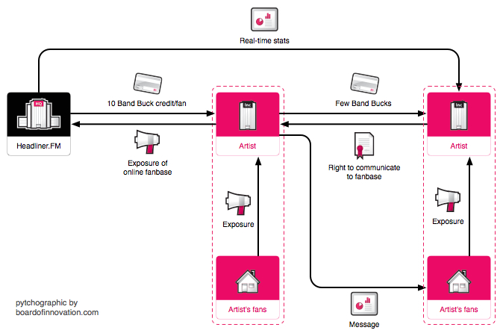
Business Model Design made easy
eBay, Zopa, Skype, free newspapers, RyanAir, RadioHead… A lot of success stories are based on new business models.
Design your own business ideas with these building blocks, and find inspiration in other innovative business concepts. Example below: headliner.fm

Slide 5














Build your business model with these 16 blocks (download this file to edit)
6 players
My company
Company
Consumer
Supplier
Non-profit
Government
10 objects
to exchange
product
service
experience
exposure
reputation
money
less money
data
right
credits

Slide 6
Download this file & try it yourself!
My company
http://www.boardofinnovation.com/business-model-templates-tools/
Downloads de apoio
Powerpoint template (link)
http://www.boardofinnovation.com/templates/business_model_template.ppt
Slideshare (link)
http://www.slideshare.net/boardofinnovation/business-model-template-design-with-blocks
Google Drawer (link)
https://docs.google.com/embeddedtemplate?id=1U98Rco7ClaUvDcbVVG2Cg_6H-57627i2YtkWs7bRGaw

Slide 7


E-Business Meu E-business
Prof. Marcílio Oliveira
marcilio.oliveira@gmail.com

